Slide 1

Embedded Vision Summit Santa Clara, May 2017

Slide 2
Embedded Vision Summit 2017
Yearly event since 2012
Focus: practical computer vision and visual intelligence
Past talks are free to access!

Slide 3
What is Embedded Vision anyway?

Slide 4
Overall
Multiple tracks:
technical insights track
enabling technologies
Business
Fundamentals
Showcase
Not surprisingly: AI focused

Slide 5
Microsoft: 3D Computer Vision and Mixed Reality
Speaker: Marc Pollefeys
Microsoft HoloLens
3D computer vision
Architecture

Slide 6
Applications
3D learning/ medical
https://www.youtube.com/watch?v=h4M6BTYRlKQ

Slide 7
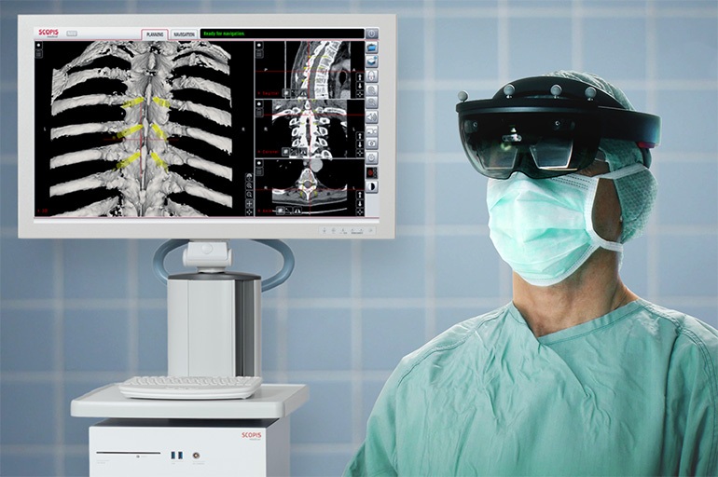
Applications: Medgadget
Scopis Introduces Mixed Reality to Simplify Surgical Navigation
https://www.youtube.com/watch?v=xvbWE4OsKxY

Slide 8
Other Applications
Tele presence, design

Slide 9
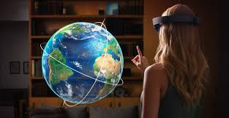
What will happen by 2020?
Time to reflect:
2014: keynote on AI
2017: AI explosion
2017: Keynote on Augmented/Mixed Reality
2020: ?

Slide 10
Microsoft: Emotion Recognition
Applications

Slide 11
Basic Emotion Types

Slide 12
AI Architecture

Slide 13
Data Collection

Slide 14
Data Collection (cont.)

Slide 15
Crowd Sourcing Labeling

Slide 16
How many taggers needed?

Slide 17
Final Dataset

Slide 18
Examples
Happiness: 0.63
Disgust: 0.27
Happiness: 0.43
Neutral: 0.55

Slide 19

Try Emotion Recognition
https://azure.microsoft.com/en-us/services/cognitive-services/emotion/
Search for Microsoft emotion
recognition API

Slide 20
Jeff Bier: Conference Founder
The power and power consumption of vision computing will decrease by 1000 over the next three years.

Slide 21
Why does this matter?

Slide 22
How will we get there?

Slide 23
Algorithms

Slide 24
Processors

Slide 25
Processors

Slide 26
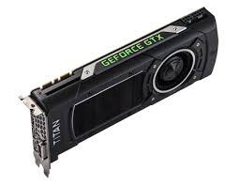
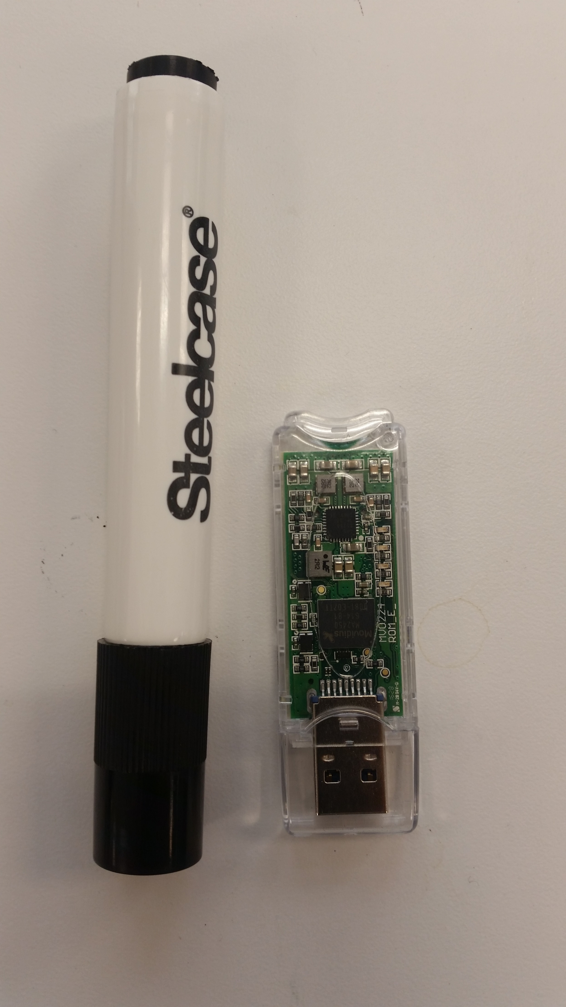
Processors
GPU vs USB stick

Slide 27
Frameworks and SW tools

Slide 28
1000 times in three years

Slide 29
What does this mean?

Slide 30
Orcam: for visually impaired
cost today: $3500

Slide 31
The people person Tie Tack

Slide 32
Empathetic Teddy Bear

Slide 33
Today we have

Slide 34
ARM: Tim Ramsdale
This changes everything. Why computer vision will be everywhere.

Slide 35
Many sensors today are proxies of vision
Sensors today will be replaced by cameras

Slide 36
Vision technology to prevent heart failure
Home Heart Failure Monitoring
Swollen ankles and heart failure
http://www.hftech.org/

Slide 37
Vision technology to prevent heart failure

Slide 38
Vision Technology in logistics

Slide 39
Vision Technology in Agriculture

Slide 40
Vision in the home

Slide 41
The Time for imaging is now …

Slide 42
What does the future hold?

Slide 43
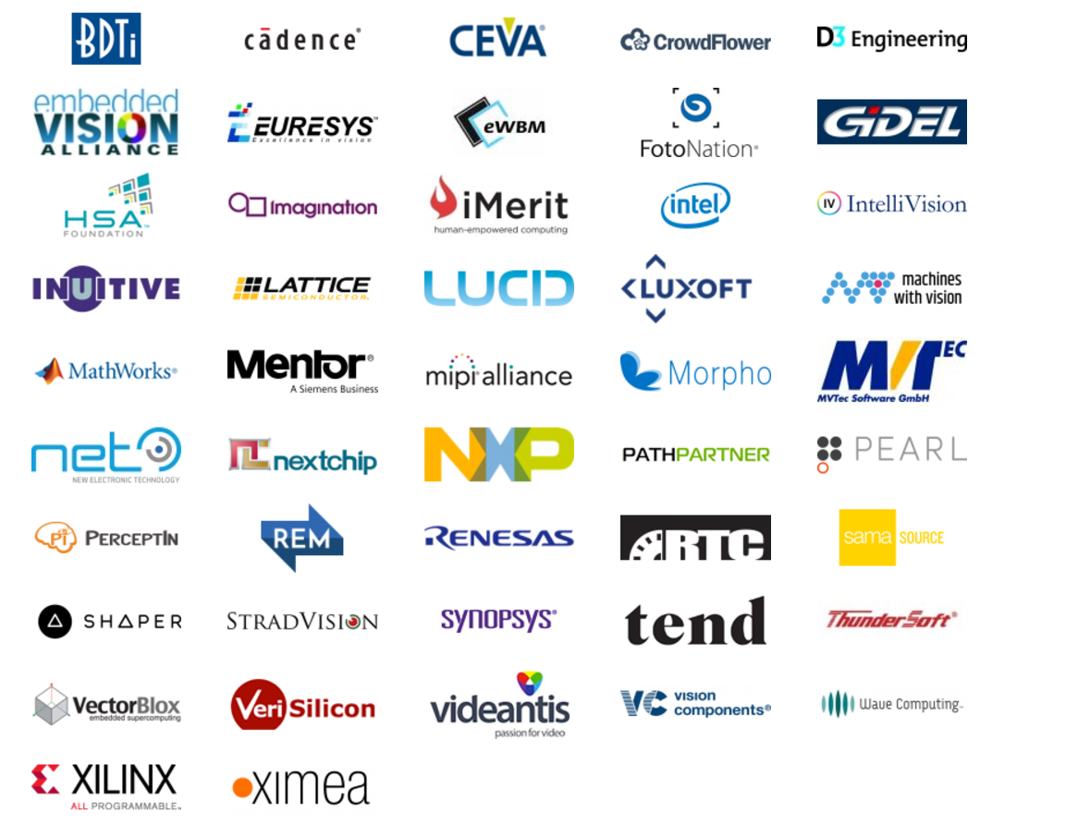
Showcases

Slide 44
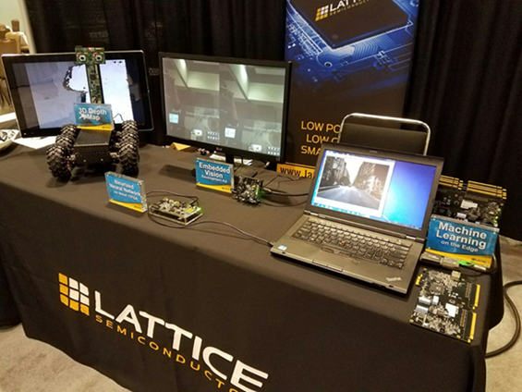
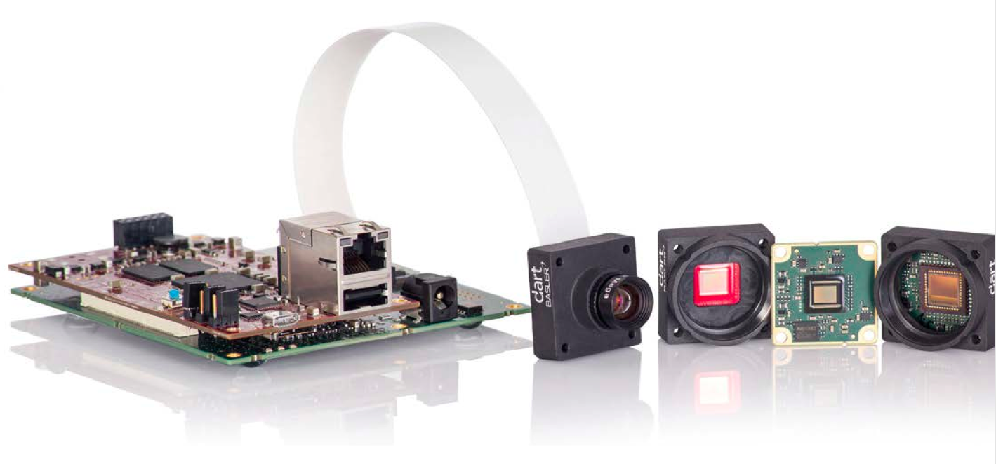
Semiconductors

Slide 45
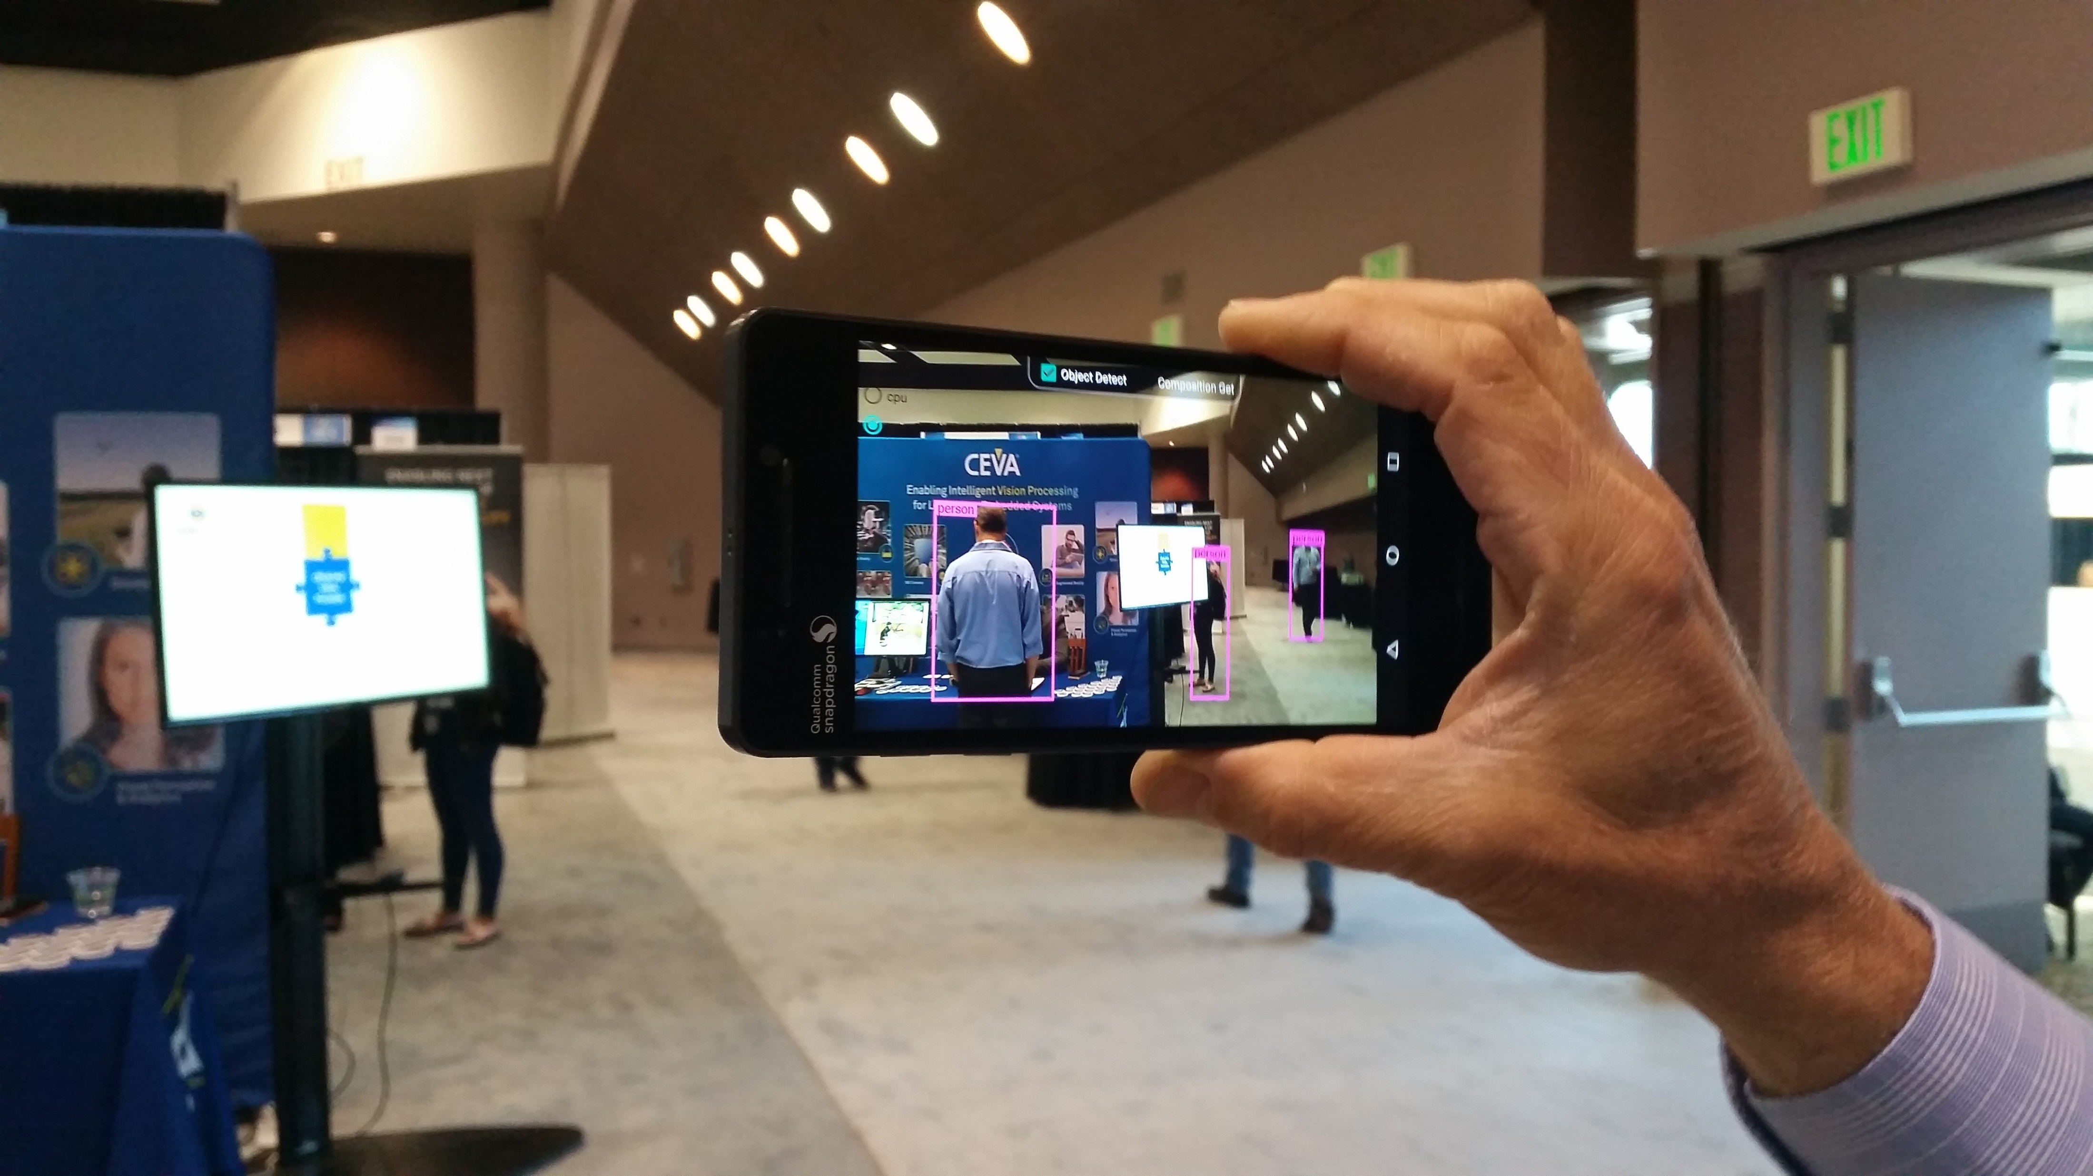
Object Detection on Smartphone

Slide 46
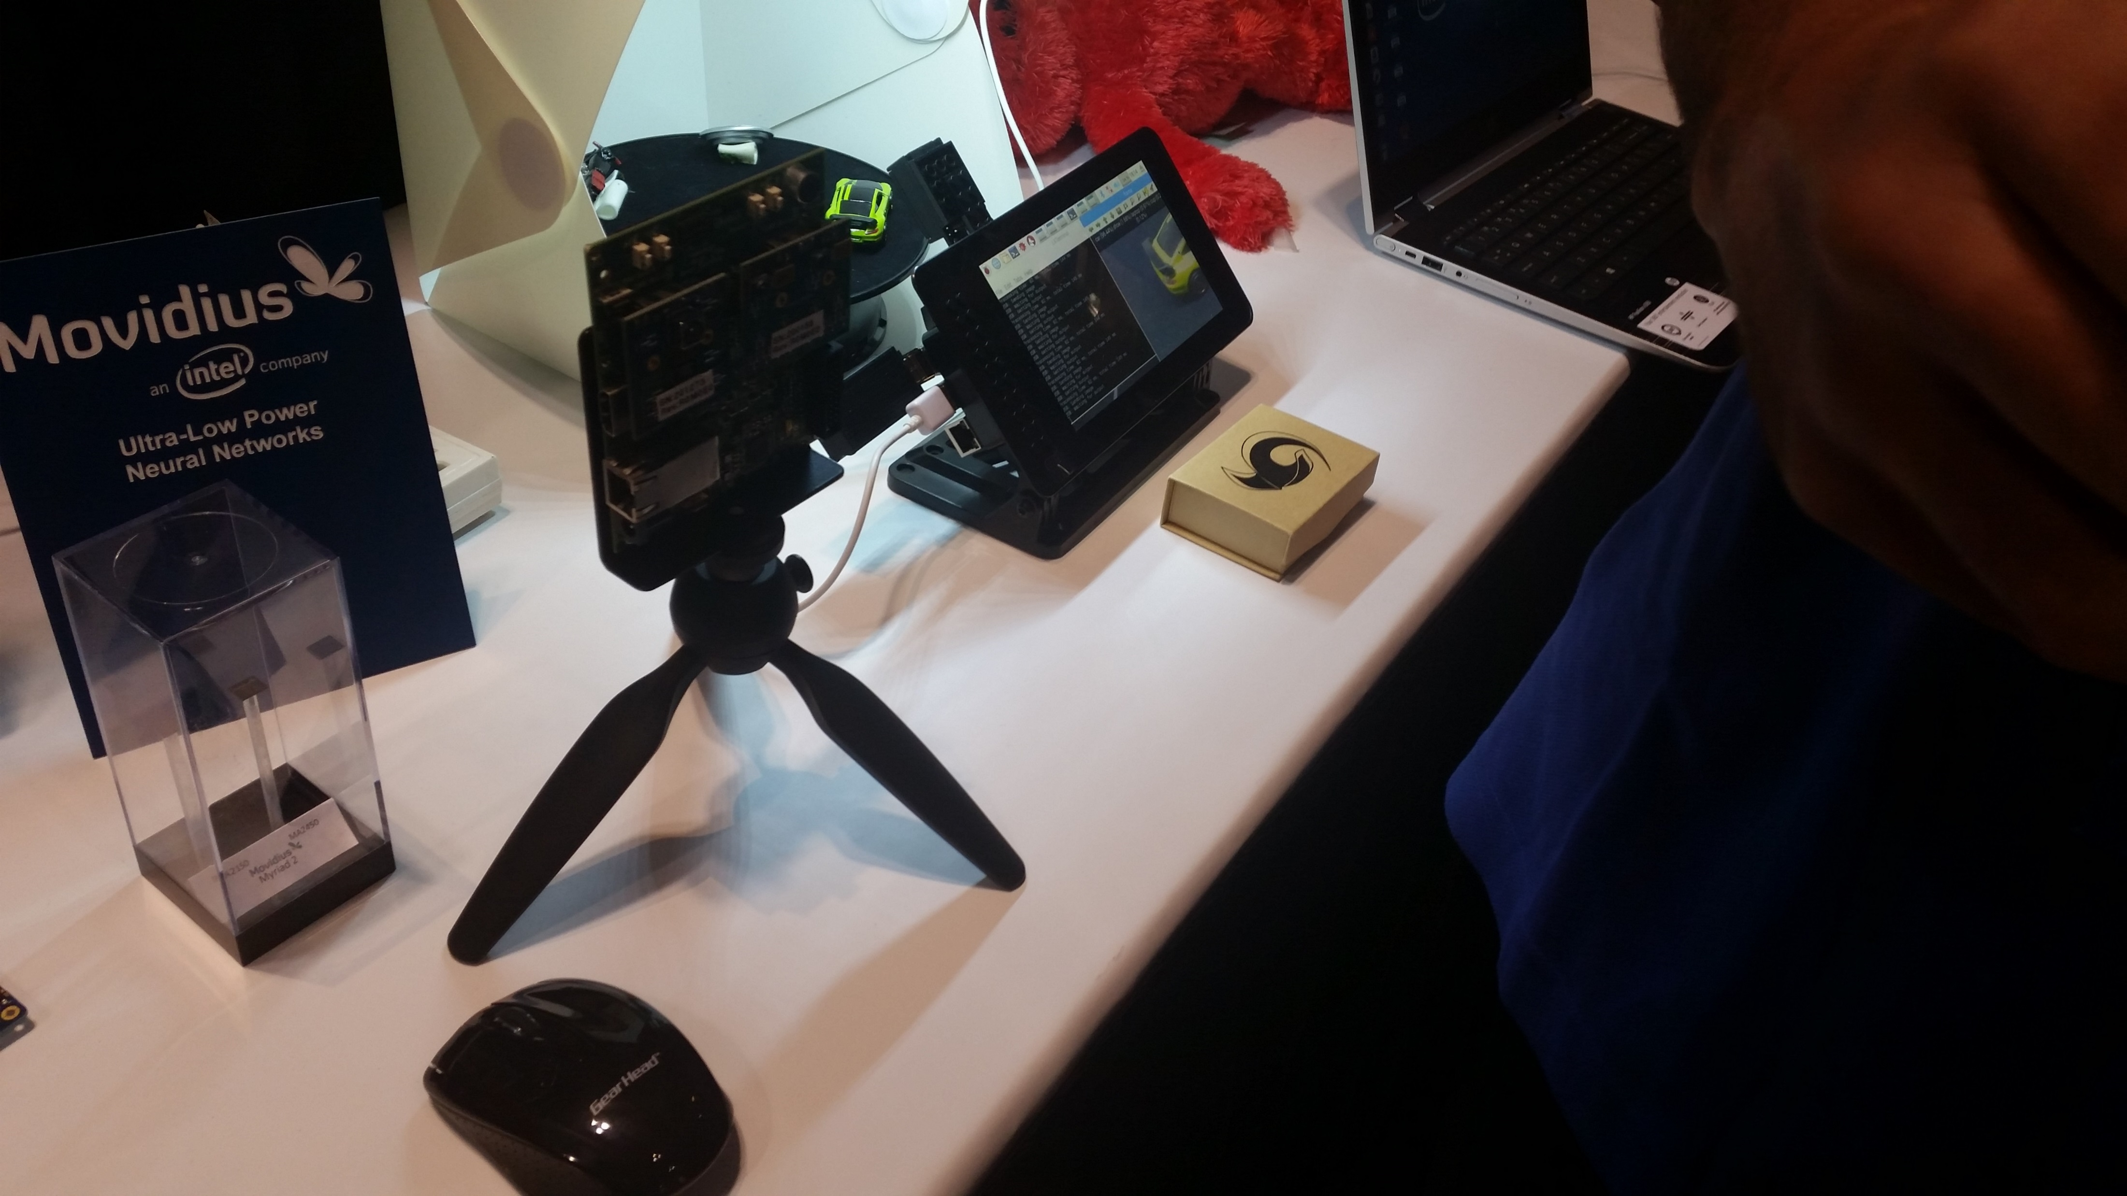

Object Detection on USB Stick

Slide 47
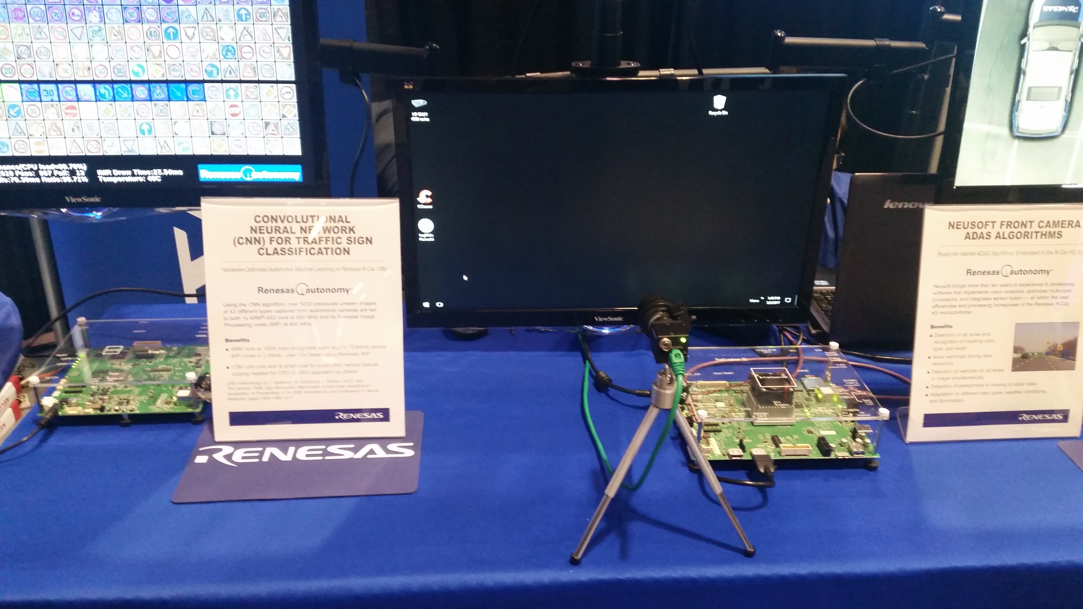
Traffic Sign Classification

Slide 48
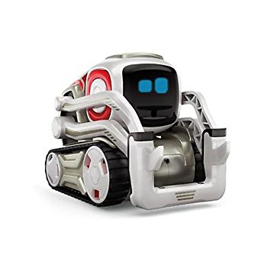
Pain Management
Entertainment for pain management!
Cozmo robot
Autonomous Robot
Interactive, aware
https://www.youtube.com/watch?v=ldi1NCpe2Aw

Slide 49
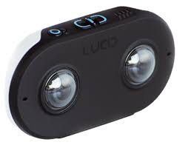
LUCID
https://www.youtube.com/watch?v=9SZldrmCg10
3D VR Camera
Cost: $499.00

Slide 50
Summary
Vision is everywhere
Machine vision is getting smarter using AI
Specialized processors for smart machine vision are coming
Lots of opportunities for healthcare industry

